Slide 1
Tourism in India
“Embracing cultures, capturing moments”

Slide 2
What is tourism?
Tourism is the travel for recreational (fun),leisure(rest),family or business purposes, usually of a limited duration.
we can say
Tourism is commonly associated with trans-national travel ,but may also refer to travel to another location within the same country.
Temporary, short-term movement of people to destination outside resident places.

Slide 3
Who is tourist?
The world tourism organization defines tourists as people “travelling to and staying in places outside their usual environment for not more than our consecutive year for leisure, business and other purpose”.

Slide 4
Forms of tourism
Domestic tourism:
Domestic tourism is tourism involving residents of one country travelling only within that country.
Inbound tourism:
incoming tourism is also known as ‘inbound tourism'. Incoming tourism means travelers arriving different countries form their own.

Slide 5
Different types of tourism in India
History tourism
Adventure tourism
Medical tourism
Eco system
Cultural tourism
Pilgrimage tourism
Spiritual tourism
Beach tourism

Slide 6
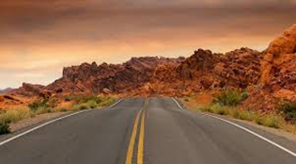
Nature of tourism
India as a tourism destination is the toast of the world at the moment.
Coned nest ranked India amongst the top 10 tourist destinations.
Travel and tourism industry is the second highest foreign exchange earner for India.

Slide 7
Foreign tourism arrival(FTA’s)in India
The number of FTAS in India during:
2010 : 5.78 million
2011 : 6.29 million
2012 : 3.76 million.
The number of foreign tourist arrivals in the country in 2013 showed an increase of about 4.1% over 2012.

Slide 8
FTA’s (% share of top 10 source countries in India in 2013

Slide 9
VISITING
Top 10 visited by foreign tourist.
Top 10 states visited byb domestic tourist
Maharashtra
Tamil nadu
Delhi
Uttar-Pradesh
Rajasthan
West Bengal
Bihar
Kerala
Karnataka
Himachal Pradesh
Uttar Pradesh
Andhra Pradesh
Tamil nadir
Karnataka
Maharashtra
Madhya Pradesh
Rajasthan
Uttarkhand
West Bengal
Gujarat

Slide 10
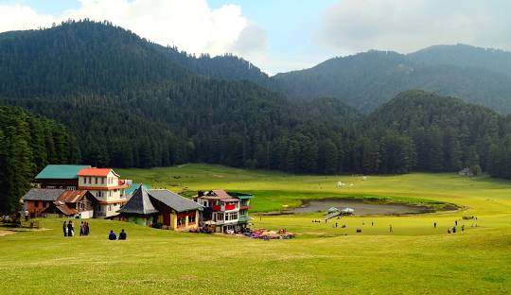
Khajjiar
Khajjiar ,often called as India's Switzerland, is a hill station in chamber district of himachal pradesh.
Dating from 12th century,khajji nag temple is dedicated to a serpent god.

Slide 11
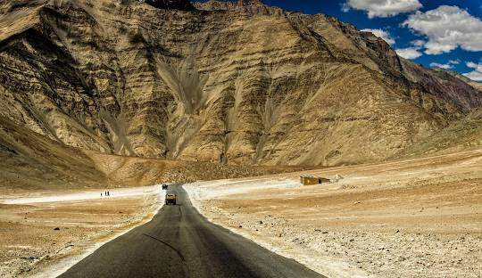
Magnetic hill

Slide 12
Initiatives taken by government to promote tourism industry
In the year 2002,the government of india announced a new tourism policy.
The policy is built around the 7-s mantra of
swaagat (welcome)
Soochanaa(information)
Suvidhaa(faciltation)
Sahyog(cooperation)
Sanrachnaa(infastructure)
Saffaai(cleanliness)

Slide 13
Thank you

